Slide 1


Unit-03 Directives and Forms
Angular (Ng)
(2301CS411)
Prof. Arjun V. Bala
Computer Engineering Department
arjun.bala@darshan.ac.in
9624822202

Slide 2

Outline
Directives
Observable
Dependency Injection
Forms
Template Driven Forms
Reactive Forms
Looping

Slide 3
Directives
Section - 01

Slide 4
Directives
Directives are classes that add additional behaviour to elements in your Angular applications.
Directives are markers in the Document Object Model(DOM).
Directives can be used with any controller or HTML tag which will tell the compiler what exact operation or behaviour is expected.
There are some directives present that are predefined but if a developer wants, they can create new directives (custom-directive).
Types of Directives
Component Directives:
Components are directives with templates. They are the building blocks of Angular applications, encapsulating both the UI (User Interface) and the behaviour of a part of the application.
Attribute Directives :
Change the appearance or behaviour of an element, component, or another directive.
Structural Directives :
Change the DOM layout by adding and removing DOM elements.

Slide 5
Attribute directives
Attribute directives listen to and modify the behaviour of other HTML elements, attributes, properties, and components.
Attribute directives change the appearance or behavior of DOM elements or components. It is used just like a normal HTML attribute.
However, the directive should be enclosed within square brackets [ ] to bind it to the element.
The most common built-in attribute directives are as follows:
Attribute Directive | Description | Example
NgClass | Adds and removes a set of CSS classes. | [ngStyle]="{'color': 'blue', 'font-size': '14px'}"
NgStyle | Adds and removes a set of HTML styles. | [ngClass] = "dark"
NgModel | Adds two-way data binding to an HTML form element. | [(ngModel)]="user.username"

Slide 6
Structural Directives
Structural directives change the structure of DOM by adding or removing elements at runtime.
This type of Angular Directive is used to show or hide elements based on user authentication, render dynamic lists from APIs, or create interfaces like tabs and accordions that change based on user actions.
The structural directives are applied to elements by prefixing the directive name with an asterisk (*) symbol.
To use these directives in your angular application, importing CommonModule is necessary as they are part of this module.
The most common built-in structural directives are as follows:
Directive | Description
ngIf | This directive is used to display or hide data in your application. When the given condition becomes TRUE, it will display the data, otherwise, it will not.
ngFor | ngFor is used to repeat a portion of elements from the given list of items.
ngSwitch | It checks multiple conditions.

Slide 7
Example (Structural Directives)
something.component.html
something.component.ts
1
2
3
4
5
6
7
8
9
10
11
12
13
14
15
16
17
<div [ngSwitch]="semester">
<span *ngSwitchCase="1">Semester 1</span>
<span *ngSwitchCase="2">Semester 2</span>
<span *ngSwitchCase="3">Semester 3</span>
<span *ngSwitchCase="4">Semester 4</span>
<span *ngSwitchCase="5">Semester 5</span>
<span *ngSwitchCase="6">Semester 6</span>
<span *ngSwitchCase="7">Semester 7</span>
<span *ngSwitchCase="8">Semester 8</span>
<span *ngSwitchDefault>Invalid Semester</span>
</div>
<h1 *ngIf="semester>4">You Are Senior</h1>
<ul>
<li *ngFor="let temp of spi">{{ temp }}</li>
</ul>
1
2
3
4
export class SomethingComponent {
semester = 10;
spi = [2.5,5.8,4.1,3.6];
}

Slide 8
Rendering Array of Object with ngFor directive
something.component.html
something.component.ts
1
2
3
4
5
6
7
8
<table>
<tr *ngFor="let stu of students; let i=index">
<td>{{i}}</td>
<td>{{stu.name}}</td>
<td>{{stu.marks}}</td>
<td>{{stu.isFailed}}</td>
</tr>
</table>
1
2
3
4
5
6
7
8
9
10
11
12
13
14
15
16
17
18
19
export class SomethingComponent {
students = [
{
name:"arjun",
marks:23,
isFailed:true
},
{
name:"darshan",
marks:85,
isFailed:false
},
{
name:"rajkot",
marks:14,
isFailed:true
}
]
}

Slide 9
Custom Directives
A custom directive is a user-defined directive that allows developers to extend the functionality of HTML elements.
The attribute and structural built-in directives (covered in previous two chapters) offers very basic and pre-defined functionalities.
However, with custom directives, you can add specific behaviors to HTML elements based on project requirements, user interactions, or changes in data.
Features and Uses of Angular Custom Directives:
The first and most basic feature of a custom directive is to modify the structure or appearance of DOM elements based on your specific logic.
It allows you to embed event listeners to the HTML elements so that their behavior can be changed in response to user interaction.
You can create a reusable and modular piece of code using custom directives.
The custom directives can also help us add various features to the user interface, such as tooltip, drag and drop, form validation, dynamic styles and much more.

Slide 10
Custom Directives (Example)
To create a custom directive, run the following command in Angular CLI −
ng generate directive <directive-name>
The above command will create a new directive with the specified name and add the necessary files for it. Among these files, the most important one is TypeScript file. This file has .ts extension.
Step 01: ng generate directive customstyle
Step 02: Add below line to constructor in customstyle.directive.ts
constructor(el: ElementRef) {
el.nativeElement.style.fontSize = '24px’;
}
Step 03: <p appCustomstyle>This text is styled using custom style directive</p>

Slide 11
Observable
Angular makes use of observables as an interface to handle a variety of common asynchronous operations.
For example:
You can define custom events that send observable output data from a child to a parent component
The HTTP module uses observables to handle AJAX requests and responses
The Router and Forms modules use observables to listen for and respond to user-input events
Angular's HttpClient returns observables from HTTP method calls.
For instance, http.get('/api') returns an observable.
This provides several advantages over promise-based HTTP APIs:
Observables do not mutate the server response (as can occur through chained .then() calls on promises). Instead, you can use a series of operators to transform values as needed.
HTTP requests are cancellable through the unsubscribe() method
Requests can be configured to get progress event updates
Failed requests can be retried easily

Slide 12
Dependency Injection (DI)
Dependencies are services or objects that a class needs to perform its function. Dependency injection, or DI, is a design pattern in which a class requests dependencies from external sources rather than creating them.
Angular's DI framework provides dependencies to a class upon instantiation.
We can use Angular DI to increase flexibility and modularity in your applications.
Consider two classes, A and B. Let’s assume that class A uses the objects of class B. Normally, in OOPs, an instance of class B is created so that class A can access the objects. Using DI, we move the creation and binding of the dependent objects outside of the class that depend on them.
Advantages of Dependency Injection
Dependency Injection helps in Unit testing.
Boilerplate code is reduced, as initializing of dependencies is done by the injector component.
Extending the application becomes more manageable.
It helps to enable loose coupling, which is essential in application programming.

Slide 13
Forms
Handling user input with forms is the cornerstone of many common applications.
Applications use forms to enable users to log in, to update a profile, to enter sensitive information, and to perform many other data-entry tasks.
Angular provides two different approaches to handling user input through forms:
Reactive
Template-Driven
Both capture user input events from the view, validate the user input, create a form model and data model to update, and provide a way to track changes.
In the following slides we have information to help you decide which type of form works best for your situation.
It introduces the common building blocks used by both approaches.
It also summarizes the key differences between the two approaches, and demonstrates those differences in the context of setup, data flow, and testing.

Slide 14
Template-driven forms
Template-driven forms rely on directives in the template to create and manipulate the underlying object model.
They are useful for adding a simple form to an app, such as an email list signup form.
They're straightforward to add to an app, but they don't scale as well as reactive forms.
If you have very basic form requirements and logic that can be managed solely in the template, template-driven forms could be a good fit.
Template-driven forms use two-way data binding to update the data model in the component as changes are made in the template and vice versa.
Template-driven forms rely on directives defined in the FormsModule.
Directive | Details
NgModel | To provide two way binding
NgForm | To create top level form group instance
NgModelGroup | To group the NgModel

Slide 15
Steps to create Template Driven Form
Step 01: Build the basic form
Define a sample data model
Include required infrastructure such as the FormsModule
Step 02: Bind form tag using ngForm
Step 03: Bind form controls using ngModel
Step 04: Track input validity and control status
Step 05: Handle the form submit event using ngSubmit
<form #studentForm="ngForm" >
<input type="text" name="middlename" [(ngModel)]="data.middlename" #middlename="ngModel" required />
<form #studentForm="ngForm" (ngSubmit)="processData()">

Slide 16
Track Control State
Adding the NgModel directive to a control adds class names to the control that describe its state.
These classes can be used to change a control's style based on its state.
States | Class if true | Class if false
The control has been visited. | ng-touched | ng-untouched
The control's value has changed. | ng-dirty | ng-pristine
The control's value is valid. | ng-valid | ng-invalid

Slide 17
Example (Template Driven Form)
signup-form.component.ts
signup-form.component.html
1
2
3
4
5
6
7
8
9
10
11
12
13
14
15
16
17
18
19
20
import { Component } from '@angular/core';
import { FormsModule } from '@angular/forms';
@Component({
selector: 'app-login-form',
imports: [FormsModule],
templateUrl: './login-form.component.html',
styleUrl: './login-form.component.css'
})
export class LoginFormComponent {
data = {
firstname:'',
middlename:'',
lastname:''
}
processData(){
console.log(this.data);
}
}
1
2
3
4
5
6
7
8
9
10
11
12
13
14
15
16
17
18
19
20
21
22
23
24
<form #studentForm="ngForm" (ngSubmit)="processData()">
<table align="center" width="50%">
<tr>
<td>Enter First name</td>
<td><input
type="text"
name="firstname"
[(ngModel)]="data.firstname"
#firstname="ngModel"
required
/>
</td>
</tr>
...
...
...
<tr>
<td colspan="2" align="center">
<input type="submit"
[disabled]="studentForm.invalid" />
</td>
</tr>
</table>
</form>

Slide 18
Reactive Forms
Reactive forms provide a model-driven approach to handling form inputs whose values change over time.
We will learn how to create and update a basic form control, progress to using multiple controls in a group, validate form values, and create dynamic forms where we can add or remove controls at run time.
Reactive forms use an explicit and immutable approach to managing the state of a form at a given point in time.
Each change to the form state returns a new state, which maintains the integrity of the model between changes.
Reactive forms are built around observable streams, where form inputs and values are provided as streams of input values, which can be accessed synchronously.

Slide 19
Steps to setup reactive form
Step 01: Import ReactiveFormsModule
Step 02: Create a form group
Step 03: Bind form group and control
Step 04: Apply Validations
Step 05: Display Validation Errors
Step 06: Handle Form Submission
import { …, ReactiveFormsModule, …} from '@angular/forms';
studentForm = new FormGroup({
name: new FormControl(''),
rollNo: new FormControl(''),
semester: new FormControl(''),
spi: new FormControl('')
});
<form [formGroup]="studentForm" (ngSubmit)="addStudent()">
Name : <input type="text" formControlName="name"/> <br/>
RollNo : <input type="text" formControlName="rollNo" /> <br/>
…
…
<input type="submit" [disabled]="studentForm.invalid" />
</form>
addStudent(){
console.log(this.studentForm.value);
}

Slide 20
Example (Reactive Form)
student-form.component.ts
1
2
3
4
5
6
7
8
9
10
11
12
13
14
15
16
17
import { …, ReactiveFormsModule, …} from '@angular/forms'; @Component({
selector: 'app-student-form',
imports: [ReactiveFormsModule],
…
})
export class StudentFormComponent {
studentForm = new FormGroup({
name: new FormControl('',[Validators.required]),
rollNo: new FormControl(''),
semester: new FormControl('', [Validators.required]),
spi: new FormControl('')
});
addStudent(){
//get data using this.studentForm.value
} }
student-form.component.html
1
2
3
4
5
6
<form [formGroup]="studentForm" (ngSubmit)="addStudent()">
Name : <input type="text" formControlName="name"/> <br/>
RollNo : <input type="text" formControlName="rollNo" /> <br/>
…
<input type="submit" [disabled]="studentForm.invalid" />
</form>

Slide 21
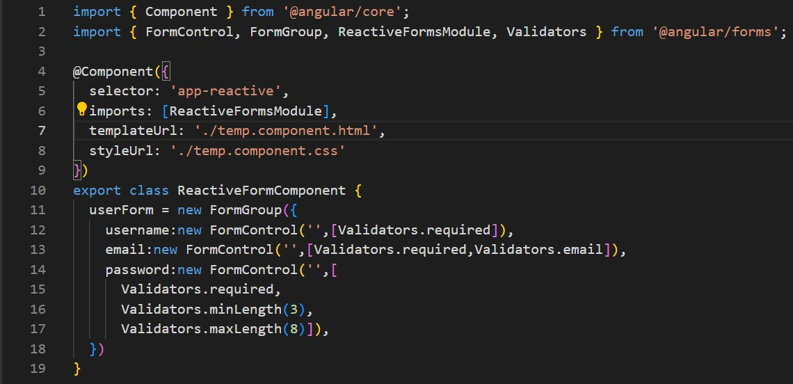
Creating FormGroup and Adding Validation Rules

Slide 22
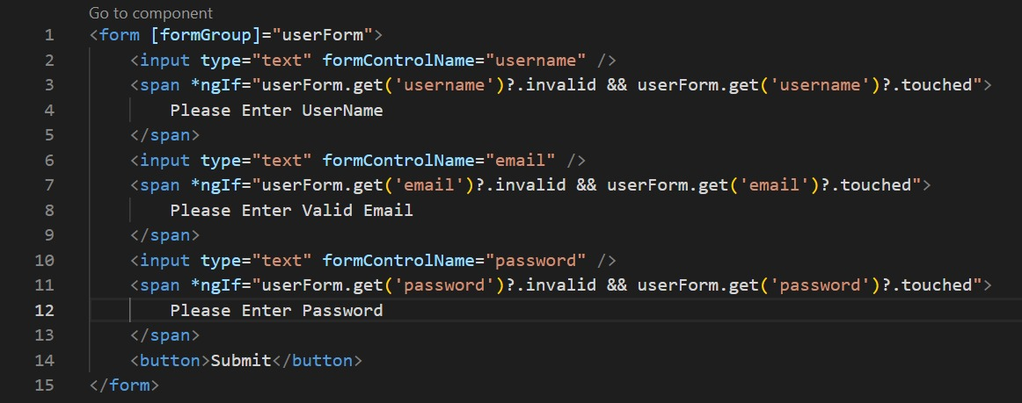
Displaying Validation Errors

Slide 23
Introduction to FormBuilder
What is FormBuilder?
What is need of FormBuilder?
A service in Angular to simplify creating and managing forms.
Reduces boilerplate code when initializing FormGroup and FormControl.
Key Features:
Simplifies form creation.
Allows dynamic form generation.
Advantages:
Reduces repetitive code.
Supports dynamic forms.
Simplifies managing nested FormGroups.
Enhances scalability and readability of form-related code.

Slide 24
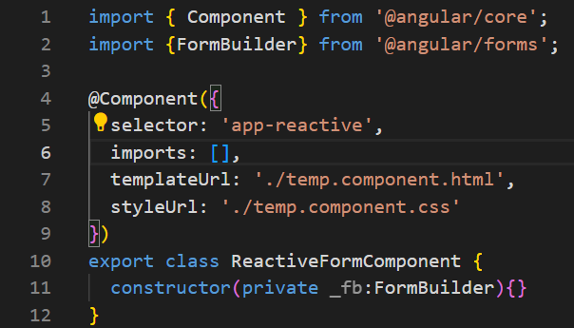
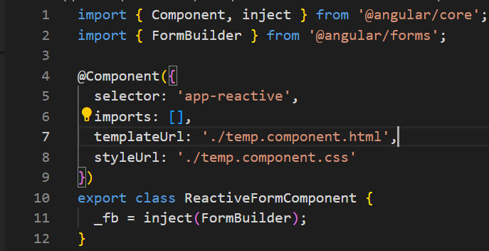
Setting Up FormBuilder
Import FormBuilder in your Component and Inject FormBuilder.
Example :
Using Constructor
(Ang. <= V.17)
Using inject method
(Ang. >= V.18)

Slide 25
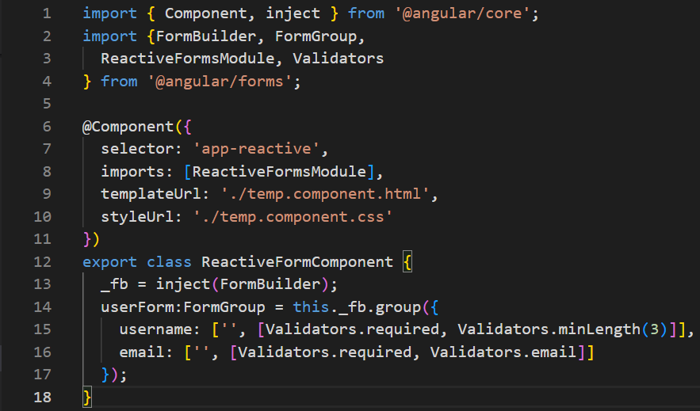
Creating FormGroup Using FormBuilder & Adding Validations
Use FormBuilder and Validators to initialize FormGroup with controls and apply Validations respectively:
Example :

Slide 26
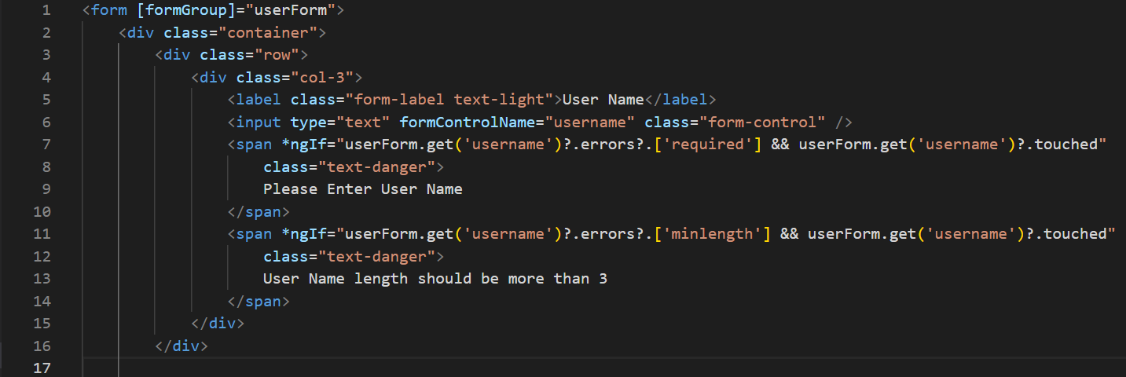
Template Binding

Slide 27
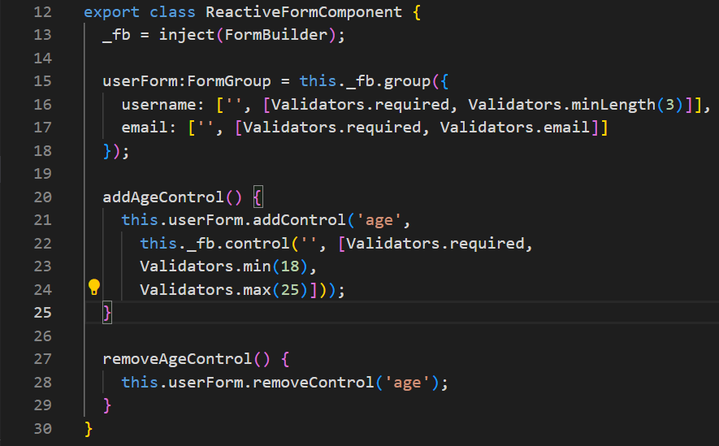
Dynamic Forms with FormBuilder
Use FormBuilder to dynamically add or remove controls:
Example :

Slide 28
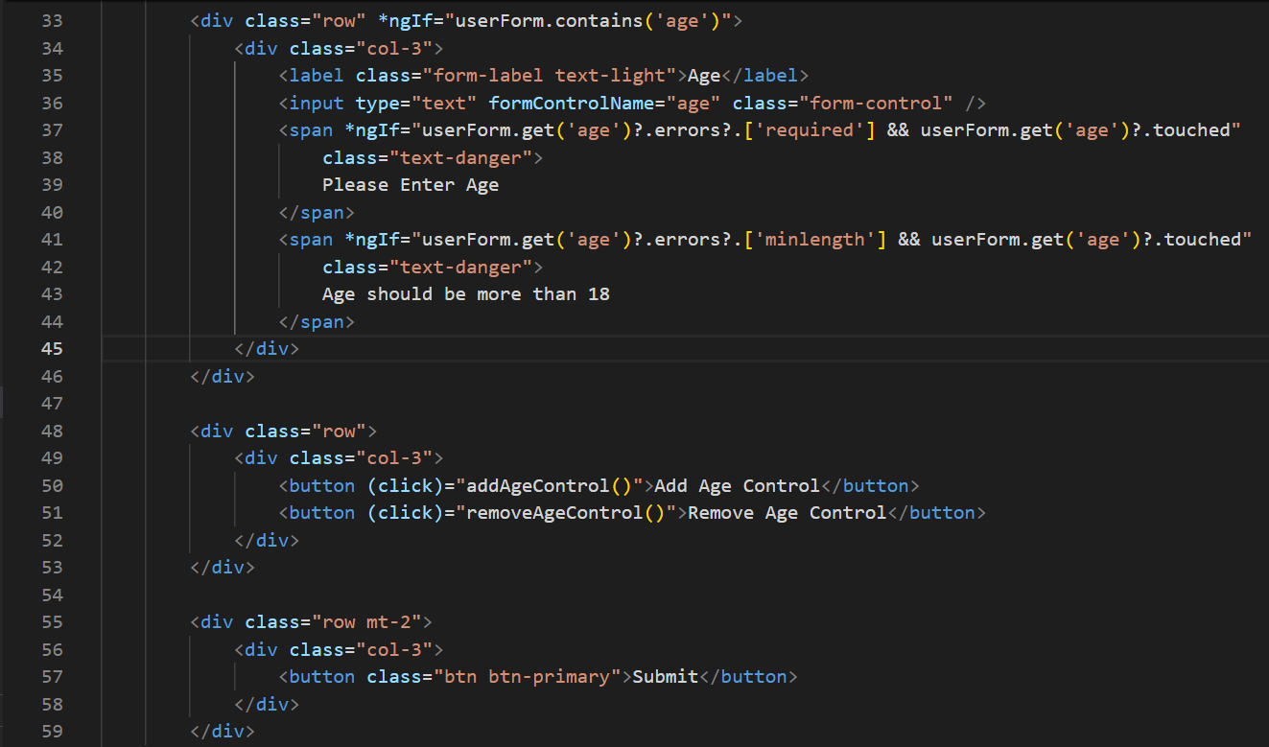
Template Binding with Dynamic form approach

Slide 29
Angular (Ng)
2301CS411
Prof. Arjun V. Bala
Computer Engineering Department
arjun.bala@darshan.ac.in
9624822202

